Slide 1

DevOps Transformation Journey
Date 18th June 2015
Version 0.026
Reviewer: TBD
Classification: Company Confidential
Company Confidential

Slide 2
Who
What
As a CIO
I want to better understand DevOps Tooling and Automation so that I can better lead PCB through Optimisation
Why
Notes:
this session is based on the feedback and suggestions from the last session (ie the user needs)

Slide 3
Executive Summary

Slide 4
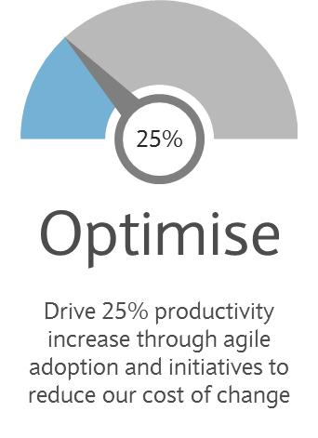
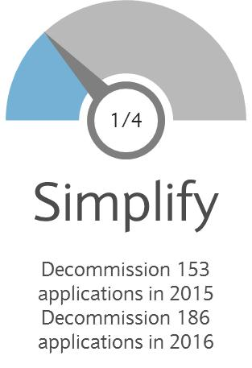
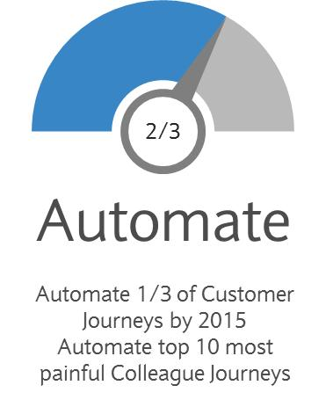
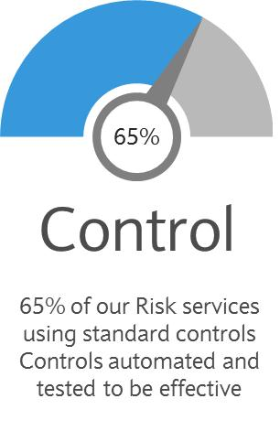
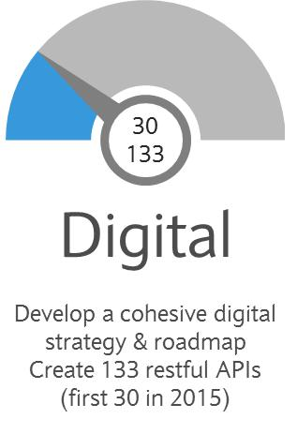
Where We Sit In The Overall Program
Implementation of DevOps is part of the overall Change Optimization Program
Program Board Control
Detailed Program Planning
Risk & Issue Management
Financial Management
Change Control
Stakeholder Engagement
Benefits Tracking
Program Manage the delivery of the salient targets defined in the PCB Technology vision and intent statements
Ensure these are clearly defined, scoped and placed under change control
Drive delivery with the support of an accountable and empowered Program Board
Provide full and clear visibility of our progress towards targets in a single place
Early sight of any issues which may impact targets, giving the opportunity to correct course

Slide 5
Where we are today
Poor tooling adoption and disparate processes impact agility and speed of projects
Poor traceability between requirements and delivery
Weak tooling adoption
Low Test coverage
Disparate processes impact test execution
Lack of integrated timely test data results in a risk based approach
Weak tool chain integration & version control leading to delays & poor quality control
Multiple handoff in deployment processes leading to high incidents in prod.
Requirements
Design
Test Design & Coverage
Env. Booking & Provision
Serial Processes, Culture & processes result in intertia, even when attempting to use Agile methodology
Environment provision and stability a consistent delivery risk across change portfolio
Iterative Build/Test/Fix Process. Defects identified later in test lifecycle, resulting in a higher cost to fix and adding delay
Iterative Build/Deploy/test cycles across multiple test phases
DEPLOY TO PROD
APPLICATION BUILD
APPLICATION DEPLOYMENT
TESTING

Slide 6
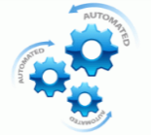

Measures and Benefits
We will track and measure our Journey to ensure we reap the benefits
Measures
+5%
+20%
>95%
Increase Tester Productivity
Drive Up Release Automation
Increase Environment Availability
-10%
-20%
0%
Reduce Missed Milestones due to poor demand management
Reduce Prod data proliferation
Ensure Implementation Effectiveness results in zero incidents
Benefits
Major avoidance of hidden costs
from removal of separating wall
Higher degree of automation and control
Much faster time to market
Continuous deployments, business agility
Increased standardisation & compliance
Notes:
Simplifying the Technology estate across product platforms & improve productivity Focused on delivering customer & colleague experiences across PCB through automation. Push button Environment commissioning to reduce time to market for apps Clear vision to improve development lifecycle from:
Quality & Efficiency
Robust Quality Management Tools
Objectives to reduce time & effort to commission new environment, reduction in infra footprint

Slide 7
DevOps Enablers - CAMS
Key enabling factors for the application teams to deliver the vision
Culture
Create a culture of cohesive delivery with all stakeholders working together, development, Test & Operations.
Automate
Enable software delivery to be a routine task with predictable results using automation.
Measure
Capture the key measurements to ensure we are making the difference, and are on the right track.
Share
Share the successes and the benefits across the organisation, creating a an environment that is conducive to a collaborative mind-set.

Slide 8








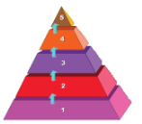

People & Process
This Is Where We Want To Be
The desired target state brings in process Standardisation and enables Autonomy to the user groups through Alignment with automation tools
Plan
Code
Build
Deploy
Operate
Test
Code
Code
Build
Deploy
Test
Operate
Production
Integration with PM tools
Check-in code & Peer review
Code Check-out & Build
Deploy
System & Regression Test
NFT
Schedule P-deployment
Auto step
Code review
Unit Test
Smoke test
Performance Test
Logging & Monitoring
Deploy to PROD
Code Quality analysis
Exploratory test
Security/ UAT
PROD verification
Manual step
PCB DEVOPS Enablement Platform
Technology
Requirements
Management
Integration
Provisioning
Continuous Integration
Test Automation
Service Virtualisation
Deployment Automation
Logging & Monitoring
Test Environment
Management
Benefits
~25%
Spend Optimisation
20% Increase in
Automation
20%
Build & Release Optimisation
Increased Process
Standardisation & Maturity
Technology Standardisation
& Compliance

Slide 9
Our Approach to Deliver
Solution delivery approach involves steering DevOps adoption by building the foundation platform as part of the Pilot. Post-pilot rollouts to have feedback mechanism for continuous improvement
Foundation/ Enabler Build - Pilot
Application Rollouts
Roadshows/
Brownbags
Enterprise wide roll out
Assess and finalize
Establish Core Team
PILOT
PoC – Quick Wins
Identify / Build Primary Enablers
Analyze
Data Collection
Application Inventory
Clustering
Integrations
Identify Key Areas of Improvements
Tools – new/existing
Continuous Delivery
Test automation
Continuous Integration
Strategize
Plan - Definition of DONE
Prototype
Scope definition – 3m/6m/1yr
Evaluate against the DevOPS Maturity Model
Socialize
Champions /Evangelists
Gamification – Incentives (***)
Roll-Out
Operate DevOps teams for projects - Implement DevOps tooling for the projects
Implementation guidance
Measure and Improve
Measure Performance
Show performance in assigned domain by delivering business value
Per sprint improved usage per three sprints Pilot
Grow step by step in full Continuous delivery
Post Implementation Reporting
Lessons Learnt
Feedback from project team
Enable
Establish, Develop Enablers for the DevOPS journey
Validated Continuous Delivery
areas for the pilot with KPI’s Defined
Execute
Examine existing source code + processes
Plan pilots + tools implementation
Set up of KPI Dashboard
Team Structure and responsibilities
Pilot + DevOps tooling implementation project plan
Just enough CD (optimum risk/cost)

Slide 10









Target Operating Model
Delivery approach is aligned to the Target Operating Model, enabling agility for software releases
Project Management | Environment Provisioning | Continuous Integration | Test Automation | Service Virtualization | Logging & Monitoring | Test Environment Management
Requirement Traceability Self Service | Self Service Infrastructure as code Faster, Automated Provisioning Standards based Consistent Immutable servers Ability to test new ideas, product upgrades, specific test scenarios with on-demand capability | Automated builds, testing and deployments Ability to capture, identify issues early into the development cycle Enhanced build and release processes supporting continuous delivery Lean / Agile processes Rare Production rollbacks | Automated smoke, regression, performance and security test Fail Fast and fail early in a release cycle Shift left Faster test cycles Improved quality and reliability of software delivery Rare Defects on Production | Ability to test independently Ability to test against legacy or new versions of upstream / downstream systems Less dependency on full stack of environments for test phases | Complete view of the impact of change per code / config change Ability to Identify potential performance and security impacts to environments View of availability and usage patterns of the environments | Ability to request, schedule, book, validate, reclaim and chargeback Service Transformation Environment Consolidation & Optimization

Slide 11
Stages & Activities
Solution delivery will involve design, execution and application teams coming together to execute activities in stages
LAUNCH
PILOT
APPLICATIONS
STEADY STATE &
GROWTH
ON-BOARDING
Implementation Design
Analytics Implementation
SOLUTION
DESIGN
TEAM
Test Driven Infrastructure
Training & Mentoring
Survey & Assessment creation
Workflow assessment
Capacity & Team Ramp up plan
SI Capacity Ramp Up
Barclays Capacity Ramp Up
DevOps Patterns
Service Virt. Patterns
On Boarding activities
Prioritized list of items
Standardize on DevOps Platform
Execution
TEAM
Test Automation Patterns
Jira backlog of items
Test Env Mgmt Patterns
Journey Assessment
Engagement & gap assessment
(infra, tools & processes)
Trouble Shooting & Roadmap briefings
Success patterns & Community Building
Onboarding Team

Slide 12
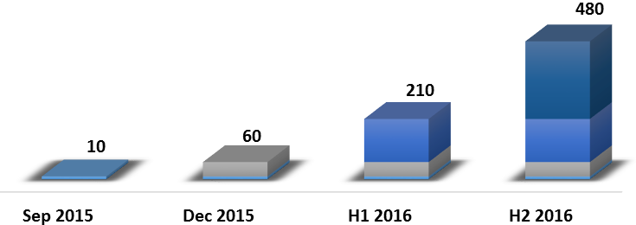
Application On-boarding - Phased Delivery
Phased approach, landing groups of apps onto the DevOps platform, while the platform matures towards the target state over time.
Small set of apps for pilot
Minimum Viable Product available in the form of CI + Release Automation + Automated consistent Build practices.
As time progresses, applications groups move to the next level of maturity on the platform, as platform matures.
Target state achieved over a period of time across a number of phases.
DevOps Platform Maturity
Applications Maturity
App Group 1
Optimised
Measured
Consistent
Repeatable
Regressive
App Group 1
App Group 2
App Group 1
App Group 2
App Group 3
App Group 1
App Group 2
App Group 3
App Group 4
Wave 1 (Pilot)
Wave 2
Wave 3
Wave 4
Cumulative View of Application On boarding

Slide 13
Assessment & Onboarding Criteria
Pilot and post-pilot rollouts will be executed in 4 waves over a 2 year journey. Quick wins will be targeted in earlier waves to gain confidence amongst application/ user groups
Barclays Application Ecosystem
Payments | Corporate | … Java | .NET | Siebel | …
TARGET
1-3 mo
Builds: Continuous
Environments: On Demand
Automation Testing: 85% automation coverage
Release: Auto-deployments to CIT, ST. 1-click to E2E SIT, UAT, NFT, OAT
Validation: 100% automatic
Logging/Monitoring: Real time ELK based
DevOps Enablement Framework
Tech Stack
DevOps Readiness Evaluation
Arch Evaluation
Application Profiling
Platform Architecture and Design (e.g. PaaS: Docker, Open Shift etc.| COTs: Nolio etc | Cloud NPE)
A List DevOps Ready (20%)
Criteria:
Tech Stack: Java
Deployment Method: Package based deploy
Example:
X% of Payments
Y% of Corporate etc.
B List Need Change (30%)
Criteria:
Tech Stack: Java, .NET, Database
Deployment Method: Scripts, Objects, Packages with Custom Integrations
C List Not Ready (50%)
Criteria:
Tech Stack: COTS, Legacy
Deployment Method: scripts, objects, packages with custom integrations
6-9 mo
9-12 mo
12-18 mo
Barclays Inputs and Dimensions
$$ - ESI Investment level
## - Strategic importance
%% - Future Growth potential
Re-Design
Packaged Deploy, Cloud Aware
10% Need Change
Simplification
Deploy, Release, Configuration
90%
Re-platform Select Applications
9-12 mo
Transform & Align Process
Standardization
Release Process, Test Environment
Apps
Growing; High Rev Impact
DevOps Platform Build Out
Align to Continuous Delivery Process
Base Impl
Customization
Application On-boarding
4 Waves
Enterprise Integration
Considerations: LOB Specific Customization | Zero disruption | 4 Waves
2 YEAR JOURNEY

Slide 14

High Level Plan
Wave 1 (Pilot)
Wave 2
Wave 3
Wave 4
10 Apps, 12 Weeks
Wk 1 | Wk 2 | Wk 3 | Wk 4 | Wk 5 | Wk 6 | Wk 7 | Wk 8 | Wk 9 | Wk 10 | Wk 11 | Wk 12
Scoping & Assessment
Scope and objectives of the strategy
Program introduction and Core Team
Data collection template
PoC Project identified and prioritization – low risk/optimal output
Foundation/ Enabler Build
Build Key enablement systems
- Private Cloud stack - JIRA/Confluence/DSL Servers/NOLIO / VTAF/KORE/ERA, JENKINS ( master/slave), NEXUS
Baseline OS build
Key tech patterns for enablement
Provisioning
Process Definition for Provisioning – Initial, intermediate and end state
Provisioning template design & builds
1. OS 2. OS + SW 3. OS + SW + APP
Tool integrations – Logging, monitoring, etc
Feedback & enhancements
DevOps
Build templates design
Build tool integrations – Code coverage, code quality, test execution
Build time provisioning &
test execution, monitoring
metrics capture & report
Build artefact upload & versioning design and implementation
Test Automation
Tooling
Priority for Automation of tests smoke/regression/functional
Tooling enablement for PoC Project teams
Integrate automation into release cycle – execution and new test case creation - Process
Service Virtualization
Tooling & Prototyping
Categorization and Identification of core backend services - Complexity, usage, integrations
Shareability across projects
Version Co-Existence & Data
Common architecture
Service Enhancements
The wave approach of delivering DevOps change transformation starts with a Pilot (Wave 1) of 12 weeks with an objective to build Platform Foundation and onboard 10 applications for early adoption

Slide 15
High Level Plan
Wave 1 (Pilot)
Wave 2
Wave 3
Wave 4
Scoping & Assessment
Scope and objectives of the strategy
Program introduction and Core Team
Data collection template
PoC Project identified and prioritization – low risk/optimal output
Platform Improvements
Build Key enablement systems
- Private Cloud stack - JIRA/Confluence/DSL Servers/NOLIO / VTAF/KORE/ERA, JENKINS ( master/slave), NEXUS
Baseline OS build
Key tech patterns for enablement
Provisioning
Process Definition for Provisioning – Initial, intermediate and end state
Provisioning template design & builds
1. OS 2. OS + SW 3. OS + SW + APP
Tool integrations – Logging, monitoring, etc
Feedback & enhancements
DevOps
Build templates design
Build tool integrations – Code coverage, code quality, test execution
Build time provisioning &
test execution, monitoring
metrics capture & report
Build artefact upload & versioning design and implementation
Test Automation
Tooling
Priority for Automation of tests smoke/regression/functional
Tooling enablement for PoC Project teams
Integrate automation into release cycle – execution and new test case creation - Process
Service Virtualization
Tooling & Prototyping
Categorization and Identification of core backend services - Complexity, usage, integrations
Shareability across projects
Version Co-Existence & Data
Common architecture
Service Enhancements
The 2 year journey of DevOps transformation will be planned as part of Waves 2, 3 and 4, with feedback mechanism to continuously improve the platform

Slide 16
Who will Deliver the Solution
Delivery execution team structure is defined and being ramped up for Wave 1 (Pilot) phase
Barclays Program Management
PROGRAM MANAGEMENT OFFICE
Working Group
Solution Architecture (Cognizant(1) + Virtusa(1) + Barclays(1))
Cognizant(1) + Virtusa (1) + Barclays PM
SOLUTION
DESIGN
TEAM
Application Onboarding
Team
(10*) plus Barclays stakeholders
TEMs SME (1)
Test Automation Lead (1)
S.V Lead(1)
Provisioning Lead(1)
CI Lead (1)
API Engineering Team Lead(1)
Design Consultants (2)
Virtusa VtaF Test Automation SME (1)
Cognizant Consultant (1)
Virtusa Integration Architect (1)
Cognizant Design Consultant (2)
Design consultant (1)
Cognizant Design Consultant (1)
Virtusa Design Consultant (1)
Design Consultant (1)
TEMS Factory (10*)
Virtusa VtaF Consultants (5*)
Cognizant Test Teams (?)
SV Factory (2*)
Provisioning Factory (2*)
CI Factory
Cognizant (5*)
API Factory (2*)
Pilot Execution
TEAM
IBM Nolio Factory
API Team
App 1
App 2
App 3
App 4
App 5
App 6
App 7
App 8
App 9
App 10
LEGEND
BARCLAYS
VIRTUSA
Cognizant
IBM
Virtusa / Cognizant / Barclays
Team structure, as defined for Pilot

Slide 17
Appendix

Slide 18
Delivery
1-3 mo
Barclays Application Ecosystem
Payments | Corporate | … Java | .NET | Siebel | …
TARGET
DevOps Enablement Framework
Tech Stack
DevOps Readiness Evaluation
Arch Evaluation
Application Profiling
Builds: Continuous
Environments: On Demand
Automation Testing: 85% automation coverage
Release: Auto-deployments to CIT, ST. 1-click to E2E SIT, UAT, NFT, OAT
Validation: 100% automatic
Logging/Monitoring: Real time ELK based
Platform Architecture and Design (e.g. PaaS: Docker, Open Shift etc.| COTs: Nolio etc | Cloud NPE)
A List DevOps Ready (20%)
Criteria:
Tech Stack: Java
Deployment Method: Package based deploy
B List Need Change (30%)
Criteria:
Tech Stack: Java, .NET, Database
Deployment Method: Scripts, Objects, Packages with Custom Integrations
C List Not Ready (50%)
Criteria:
Tech Stack: COTS, Legacy
Deployment Method: scripts, objects, packages with custom integrations
6-9 mo
9-12 mo
12-18 mo
Barclays Inputs and Dimensions
$$ - ESI Investment level
## - Strategic importance
%% - Future Growth potential
Source Code management
Continuous Integration
Automated Deployments
Service Virtualisation
Requirements Management
Automated Testing
6-9 mo
DevOps Platform Build Out
Base Impl
Customization
Application On-boarding
4 Waves
6-9 MONTH JOURNEY
Enterprise Integration
Considerations: LOB Specific Customization | Zero disruption | 4 Waves

Slide 19
Delivery
1-3 mo
Barclays Application Ecosystem
Payments | Corporate | … Java | .NET | Siebel | …
TARGET
DevOps Enablement Framework
Tech Stack
DevOps Readiness Evaluation
Arch Evaluation
Application Profiling
Builds: Continuous
Environments: On Demand
Automation Testing: 85% automation coverage
Release: Auto-deployments to CIT, ST. 1-click to E2E SIT, UAT, NFT, OAT
Validation: 90-100% automatic
Logging/Monitoring: Real time ELK based
Platform Architecture and Design (e.g. PaaS: Docker, Open Shift etc.| COTs: Nolio etc | Cloud NPE)
A List DevOps Ready (20%)
Criteria:
Tech Stack: Java
Deployment Method: Package based deploy
B List Need Change (30%)
Criteria:
Tech Stack: Java, .NET, Database
Deployment Method: Scripts, Objects, Packages with Custom Integrations
C List Not Ready (50%)
Criteria:
Tech Stack: COTS, Legacy
Deployment Method: scripts, objects, packages with custom integrations
6-9 mo
9-12 mo
12-18 mo
Barclays Inputs and Dimensions
$$ - ESI Investment level
## - Strategic importance
%% - Future Growth potential
Source Code management
Automated Deployments
Service Virtualisation
Requirements Management
Automated Testing
Application Redesign/Changes
Continuous Integration
9-12 mo
DevOps Platform Build Out
Base Impl
Customization
Application On-boarding
4 Waves
9-12 MONTH JOURNEY
Enterprise Integration
Considerations: LOB Specific Customization | Zero disruption | 4 Waves

Slide 20
Delivery
1-3 mo
Barclays Application Ecosystem
Payments | Corporate | … Java | .NET | Siebel | …
TARGET
DevOps Enablement Framework
Tech Stack
DevOps Readiness Evaluation
Arch Evaluation
Application Profiling
Builds: Continuous
Environments: On Demand
Automation Testing: 85% automation coverage
Release: Auto-deployments to CIT, ST. 1-click to E2E SIT, UAT, NFT, OAT
Validation: 90-100% automatic
Logging/Monitoring: Real time ELK based
Platform Architecture and Design (e.g. PaaS: Docker, Open Shift etc.| COTs: Nolio etc | Cloud NPE)
A List DevOps Ready (20%)
Criteria:
Tech Stack: Java
Deployment Method: Package based deploy
B List Need Change (30%)
Criteria:
Tech Stack: Java, .NET, Database
Deployment Method: Scripts, Objects, Packages with Custom Integrations
C List Not Ready (50%)
Criteria:
Tech Stack: COTS, Legacy
Deployment Method: scripts, objects, packages with custom integrations
6-9 mo
9-12 mo
12-18 mo
Barclays Inputs and Dimensions
$$ - ESI Investment level
## - Strategic importance
%% - Future Growth potential
Source Code management
Continuous Integration
Automated Deployments
Service Virtualisation
Requirements Management
Automated Testing
Align to CI/CD SDLC
Application redesign to support CI/CD
12-18 mo
DevOps Platform Build Out
Base Impl
Customization
Application On-boarding
4 Waves
12-18 MONTH JOURNEY
Enterprise Integration
Considerations: LOB Specific Customization | Zero disruption | 4 Waves

Slide 21

Technical Solution Architecture
Nexus Pro
DB Release
Management
Yum
Self Service Enablement
Requirements
Update Build
Pull Packages
User Stories
Code to Build Traceability
Chef
Environments
Trigger Build
Jira
GIT
Jenkins
Build Farms
App
Pull Code
Provisioning
Commit Code
Deployment Targets
Code Review
Config
SCM Traceability
Static Code Analysis
Nolio
Deployment
MW
Requirement Traceability
Stash
SonarQube
Test Frameworks
Deployment
OS
Jira Integration
Auto-ticketing
Audit Trail
Log Management
SNOW
Splunk / ELK
The solution binds all the key tools and components of technology estate to deliver the seamless experience.

Slide 22







Solution
PCB DevOps Enablement Platform
Features
Lean/Agile Processes
Provisioning
Continuous feedback
Fail fast/Quick feedback.
Left shift testing
Requirement tracing.
Build and Release
Automation
Test
Automation
Service
Virtualization
Monitoring
Request/Schedule/Book/Validate & Claim back Environments.
Benefits
Fewer Production failures and incidents
Log Analysis
Faster, Automated Provisioning.
Audit Trail all the way from issues/ requirements to releases.
Application Performance Monitoring
Reduced cycle time for testing
DevOps platform solution provides a fully automated, self-service platform with an auditable workflow

Slide 23
High Level Milestones
JUNE | JULY | AUGUST | SEPTEMBER
PMs Onboarded
SMEs Onboarded
Pilot Execution Team Onboarded
Design Sprint Ends
Solution Architecture Group Formed
Team Onboarding Logistics
Design Team Onboarded
Sprint 1 Ends
Sprint 2 Ends
Sprint 3 Ends
Sprint 4 Ends
Sprint 5 Ends
T-4 W | T-3 W | T-2 W | T-1 W | T | T+1 W | T+2 W | T+3 W | T+4 W | T+5 W | T+6 W | T+7 W | T+8 W | T+9 W | T+10 W | T+11 W | T+12 W
JUN 03 | JUN 10 | JUN 17 | JUN 24 | JUL 01 | JUL 08 | JUL 15 | JUL 22 | JUL 29 | AUG 5 | AUG 12 | AUG 19 | AUG 26 | SEP 02 | SEP 09 | SEP 16 | SEP 23
TOM Available
Pilot Applications Profiled
Pilot Applications Identified
Platform Foundation Elements Available
Platform v1.0 Development Complete
Platform v1.0 Launch
Pilot Applications Onboarded
Draft TOM Available
Profiling Template Defined
Partner IP Infrastructure Defined
Sandbox Infrastructure Defined
Team Structure Defined
Backlog Defined
Low Level Design Approved
Work Streams Execution Starts
Staffing Plan Defined

Slide 24
Current View
Understanding of the Problem Statement
Summary of Solution Approach
Barclays has undertaken an initiative geared towards Simplifying the Technology estate across product platforms & improve productivity
Focused on delivering customer & colleague experiences across PCB through automation.
Push button Environment commissioning to reduce time to market for apps
Clear vision to improve development lifecycle from
Quality & Efficiency
Robust Quality Management Tools
Objectives to reduce time & effort to commission new environment, reduction in infra footprint
In summary, Barclays is looking at reduce infrastructure footprint, time & effort. Focus on push button environment etc.
A lean approach by adopting agile delivery model:
Seamless integration with application management and DevOps services
Leveraging purpose built platform to unlock efficiency and drive lower cost
Deliver the solution in an iterative manner with regular show-tell sessions for user feedback
Analyze, Identify Key areas & strategize the plan.
Enable and execute leaner and smarter model
Focus on measurement, reporting & rolling out to other projects
Deploy a lean delivery approach & not disturbing the current environment
Use Best Practice tools & dashboard for enabling automation and reducing cost.
Highlight key problem area

Slide 25
The Benefits & Measures of Our Journey
Enable PCB business growth through the creation of Automated services, driving a digital revolution that is Customer & Colleague led and focused on Optimisation
Main Effort
Enable PCB business growth through the creation of world-class Technology services, driving a digital revolution that is Customer & Colleague led and focused on Simplification
1
2
3
4
5
What
Simplify our Technology estate across 9 product platforms by placing big bets on strategic technology
Fundamentally transform the way we work to achieve a 25% improved productivity
Deliver a step change in customer & colleague experiences across PCB through mass automation of journeys, instilling a culture of continuous improvement
Deliver a consistent, automated and effective control environment aligned to our risk appetite
Market leader in multi-channel digital client experiences
KPIs
 | Increase Tester Productivity | <5%
 | Increase Environment Availability | >95%
 | Drive Up Release Automation | +20%
 | Reduce Environment provisioning elapsed time. | -15%
 | Reduce prod data proliferation | -20%
 | Reduce missed milestones due to poor Demand Management | -10% TBC
 | Increase overall Operational Effectiveness | 95%
 | Ensure Implementation Effectiveness results in zero incidents | 0
2
1
2
2
3
1
2
3
4
2
1
2
3
4
5
6
7
6

